Slide 1

Stocks: Investing & Trading
Presented by
Muhammad Daud Siddiqui
Made by
Muhammad Mubashir

Slide 2



Table of Contents
Model Intro
Libraries Used
Correcting Date Pattern
Reading Files and Encoding Dates
Data cleaning
Regression i.e., investment predictions via data graph
Comparing companies via graph
Random Forest Regression
Training and testing Model
Why Random Forest Regressor
Prediction Effectiveness
Why not Linear or Logistic Regression.

Slide 3

Model Intro
The model does something

Slide 4
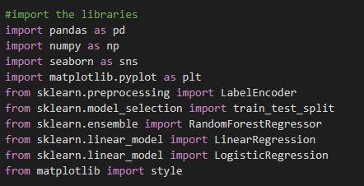
Libraries Used
Pandas used to Read data
Seaborn used to plot data visually
Matplotlib used to visualize data
Sklearn and its sub domains used to Encode data in Numbers, import Machine Learning Algorithms like Random Forest Regressor / Linear Regression and Logistic Regression also the train test split model
Style imported to style the visual graph

Slide 5

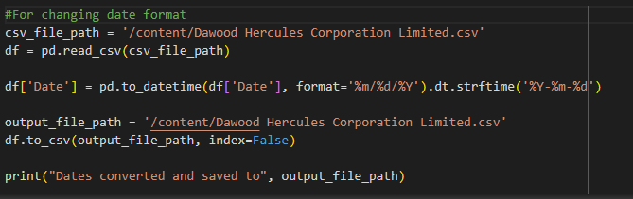
Correcting Date Patterns
Date patterns can be multiple be it mm/dd/year and similarly 8 combinations, but we tend to use only one year-month-date to encode dates properly

Slide 6
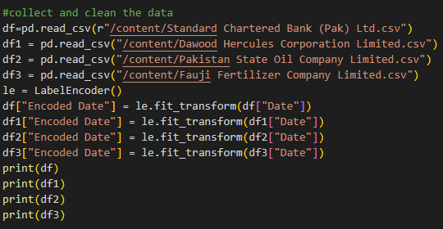
Reading Files and Encoding Data
Read the given data files using pandas
Encode dates data in numbers so it can be plotted graph
Making Label Encoder class instance

Slide 7
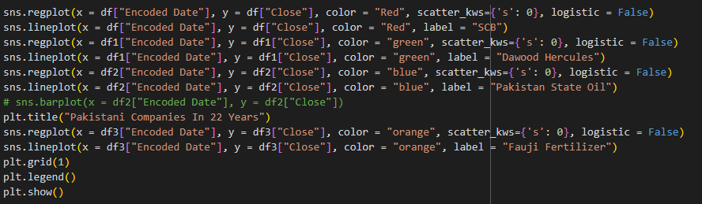
Regression i.e., investment predictions via data graph
Used seaborn for data regression lines and data line visualization fir different colors for companies that are encoded in legends.
Displayed grid

Slide 8
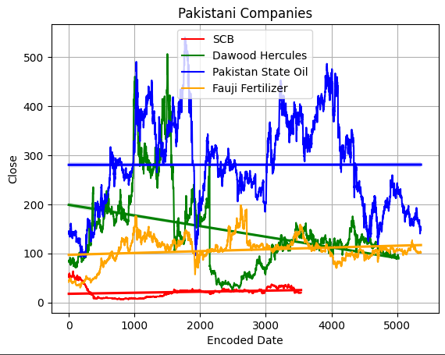
Comparing Companies via Graph

Slide 9
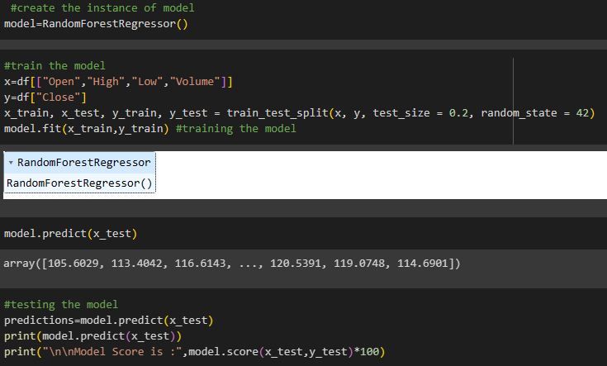
Random Forest Regression
Machine learning model to predict data

Slide 10

Why Random Forest Regressor ?
Because the random forest regression showed more effectiveness then the linear model

Slide 11

Off To Next Presentation
Daud Siddiqui

